Slide 1
Yelp Restaurant Rating
Hybrid Model
Dec 2nd, 2025
Team : Brinta, MingHao, Usha, Daniel
ITM 881 - Final Project

Slide 2
BACKGROUND & MOTIVATION
Background: The Online Review Economy
Yelp hosts 244M+ reviews influencing in consumer transactions annually
Restaurant ratings directly impact business survival
Reviews contain rich signals: sentiment, expectations, comparisons
Business Motivation
Revenue Impact: +1 star rating = + 5 - 9% revenue increase (Luca, 2016)
Performance Disparities: In our dataset, restaurants range from 4.6★ to 2.5★
Competitive Intelligence: Understanding what drives ratings enables strategic improvements
Technical Motivation
Text vs. Metadata: Which matters more for prediction?
Hybrid Approach: Can combining both improve accuracy?
Real-World Application: Philadelphia restaurant market with natural competition
https://s24.q4cdn.com/521204325/files/doc_downloads/esg/2022/Yelp-Trust-and-Safety-Report-2021.pdf
https://www.hbs.edu/faculty/Pages/item.aspx?num=41233

Slide 3
RESEARCH QUESTIONS
Primary Research Question:
Can we improve restaurant rating prediction by combining structured metadata with unstructured review text?
Specific Questions:
How well can structured features alone (categories, location) predict ratings?
Does review text provide stronger predictive signals than metadata?
Does a hybrid model (metadata + text) outperform single-source models?
Reference: https://business.yelp.com/data/resources/open-dataset/

Slide 4
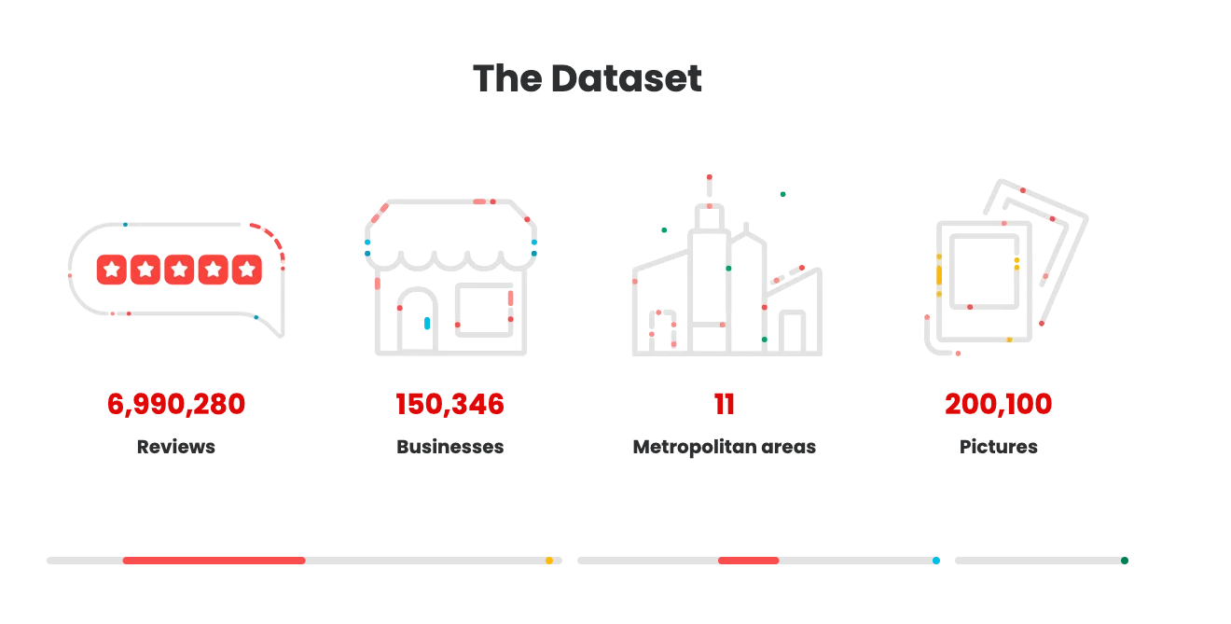
DATA COLLECTION & FILTERING STRATEGY
Data Source: Yelp Academic Dataset
• Comprehensive user-generated review platform
• Rich temporal coverage (2005-2022)
• Large-scale data supporting robust statistical inference
Multi-Stage Filtering Process:
Stage 1: Initial Dataset
→ 150,346 total businesses
→ 6.99 million reviews across all categories
Stage 2: Category Filtering
→ Filtered for "Restaurants" keyword
→ Result: 52,268 restaurants with 4.72M reviews
→ 1.45 million unique users
Stage 3: Geographic Focus
→ Selected Philadelphia market only
→ 5,852 unique restaurants
→ 687,289 reviews
Stage 4: Final Selection (Top 3 by review volume)
→ 13,499 total reviews
→ 11,275 unique reviewers
→ Sufficient data density for network construction
Reference: https://business.yelp.com/data/resources/open-dataset/

Slide 5
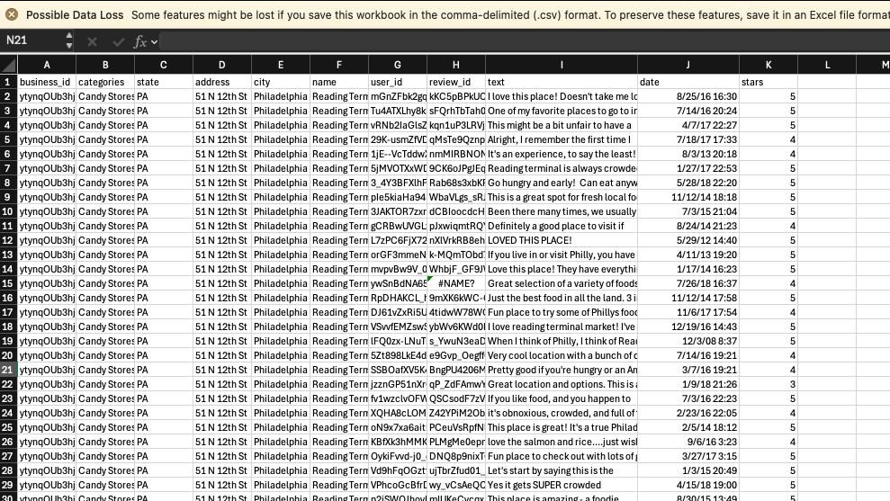

Slide 6
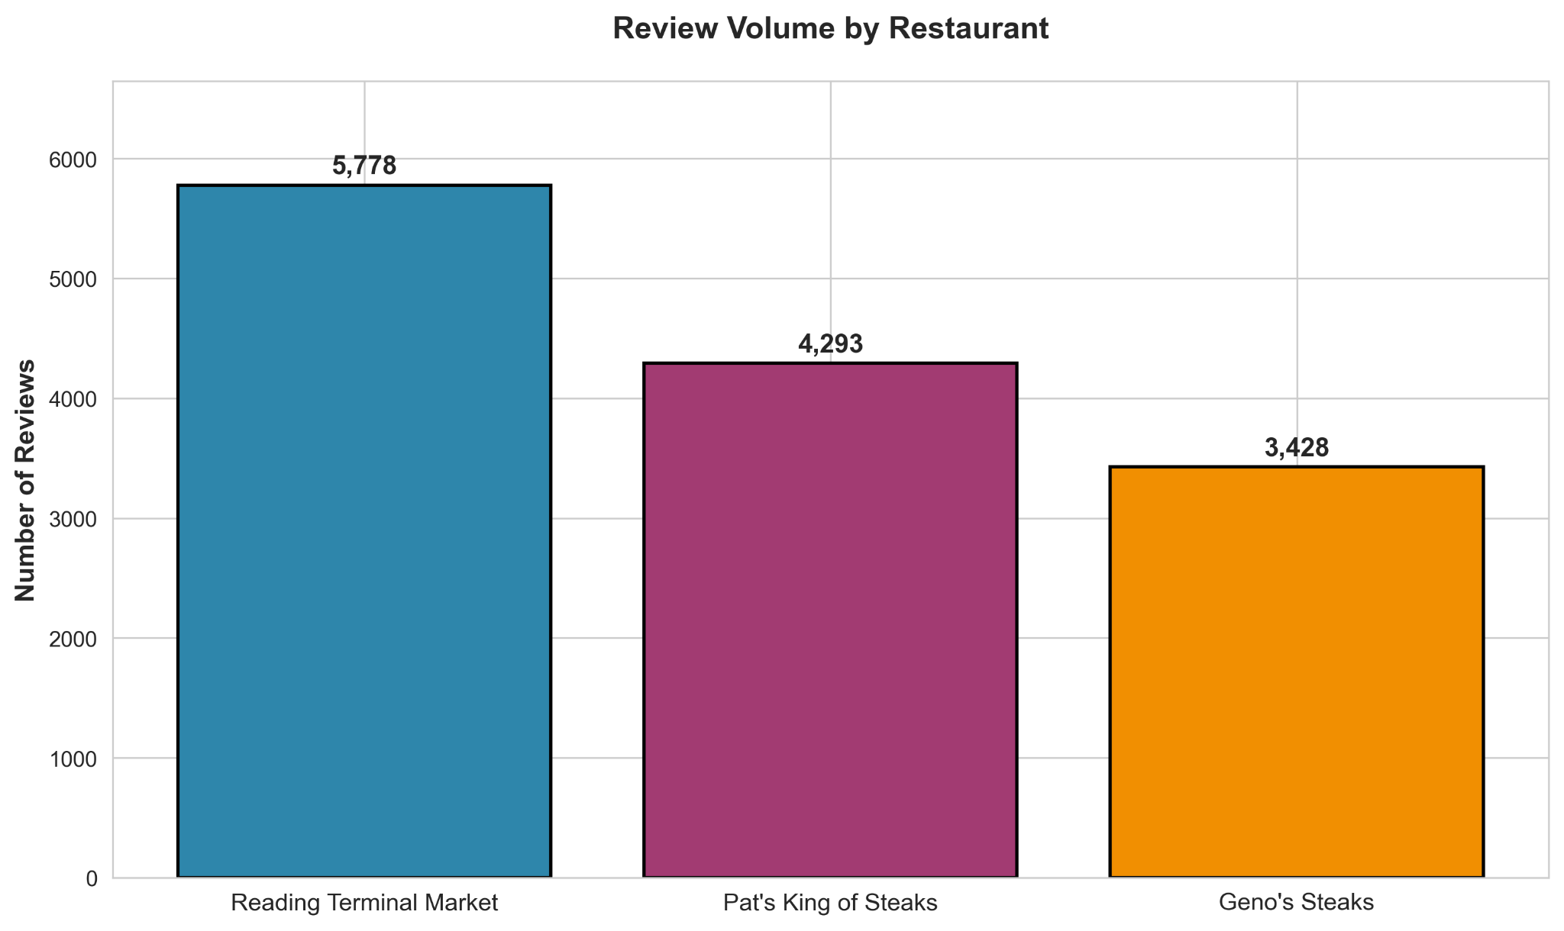
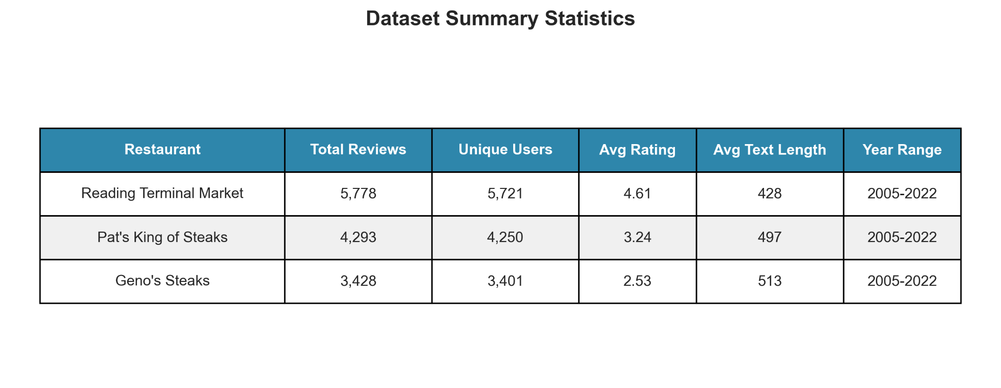
TARGET RESTAURANT SELECTION
Selection Rationale:
• Review volume = proxy for market visibility and engagement
• Mix of business models enables comparative analysis
• Clear performance differentiation (4.61 vs 3.24 vs 2.53)
Restaurant Profiles:
Reading Terminal Market (5,778 reviews)
• Historic Philadelphia food hall since 1893
• Multi-vendor marketplace with diverse cuisines
• Highest satisfaction: 69.5% five-star reviews
Pat's King of Steaks (4,293 reviews)
• Iconic cheesesteak establishment since 1930
• Claims to have invented the Philly cheesesteak
• Moderate performance: 3.24 average rating
Geno's Steaks (3,428 reviews)
• Direct competitor across the street from Pat's
• Also claims cheesesteak invention
• Polarized reviews: 29.2% one-star, 10.2% five-star
Notes:
These three restaurants represent distinct market positions. Reading Terminal is a beloved food hall with consistently high ratings. Pat's and Geno's are direct competitors—literally across the street—yet show dramatically different customer satisfaction. This variation is methodologically valuable for testing how performance affects network structure. The mix of a food hall versus direct competitors also allows us to examine complementary versus competitive network patterns.

Slide 7
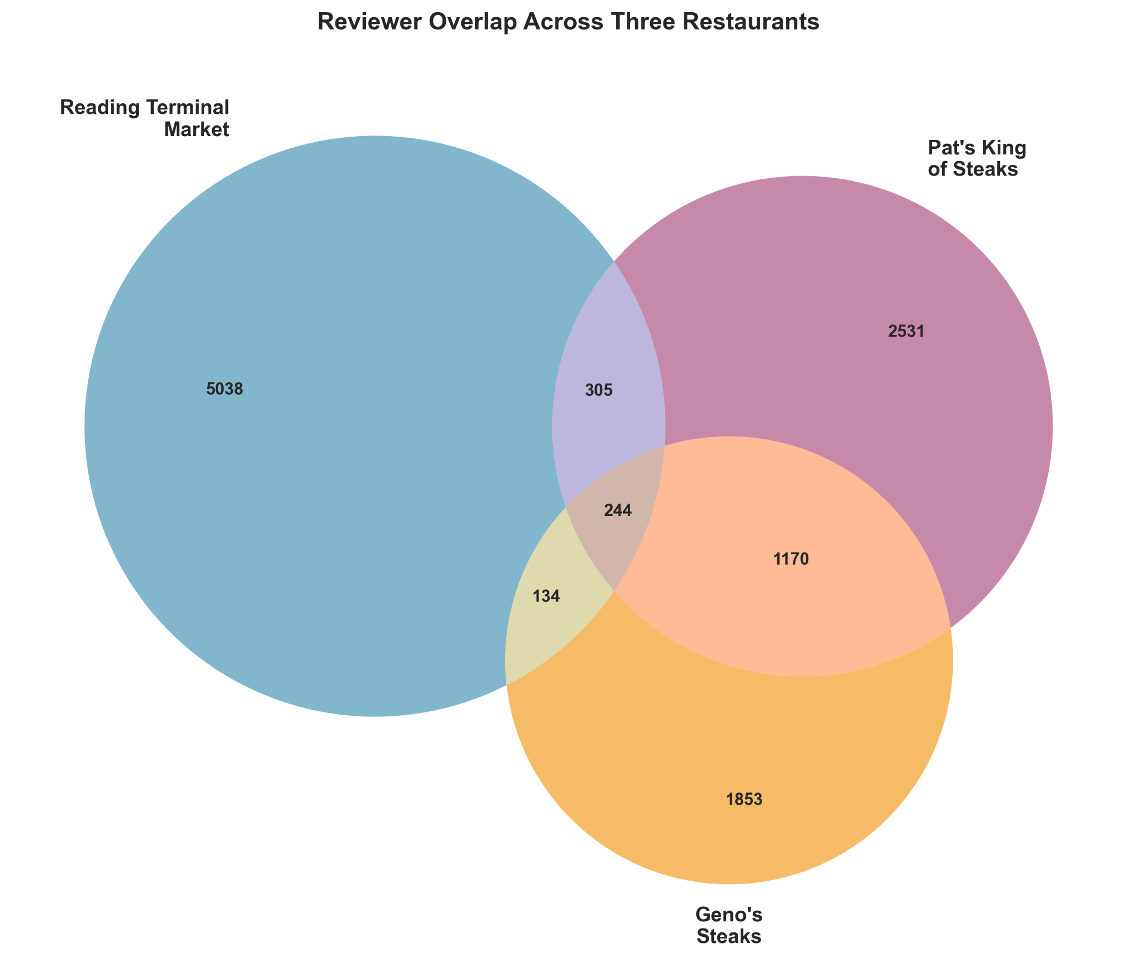
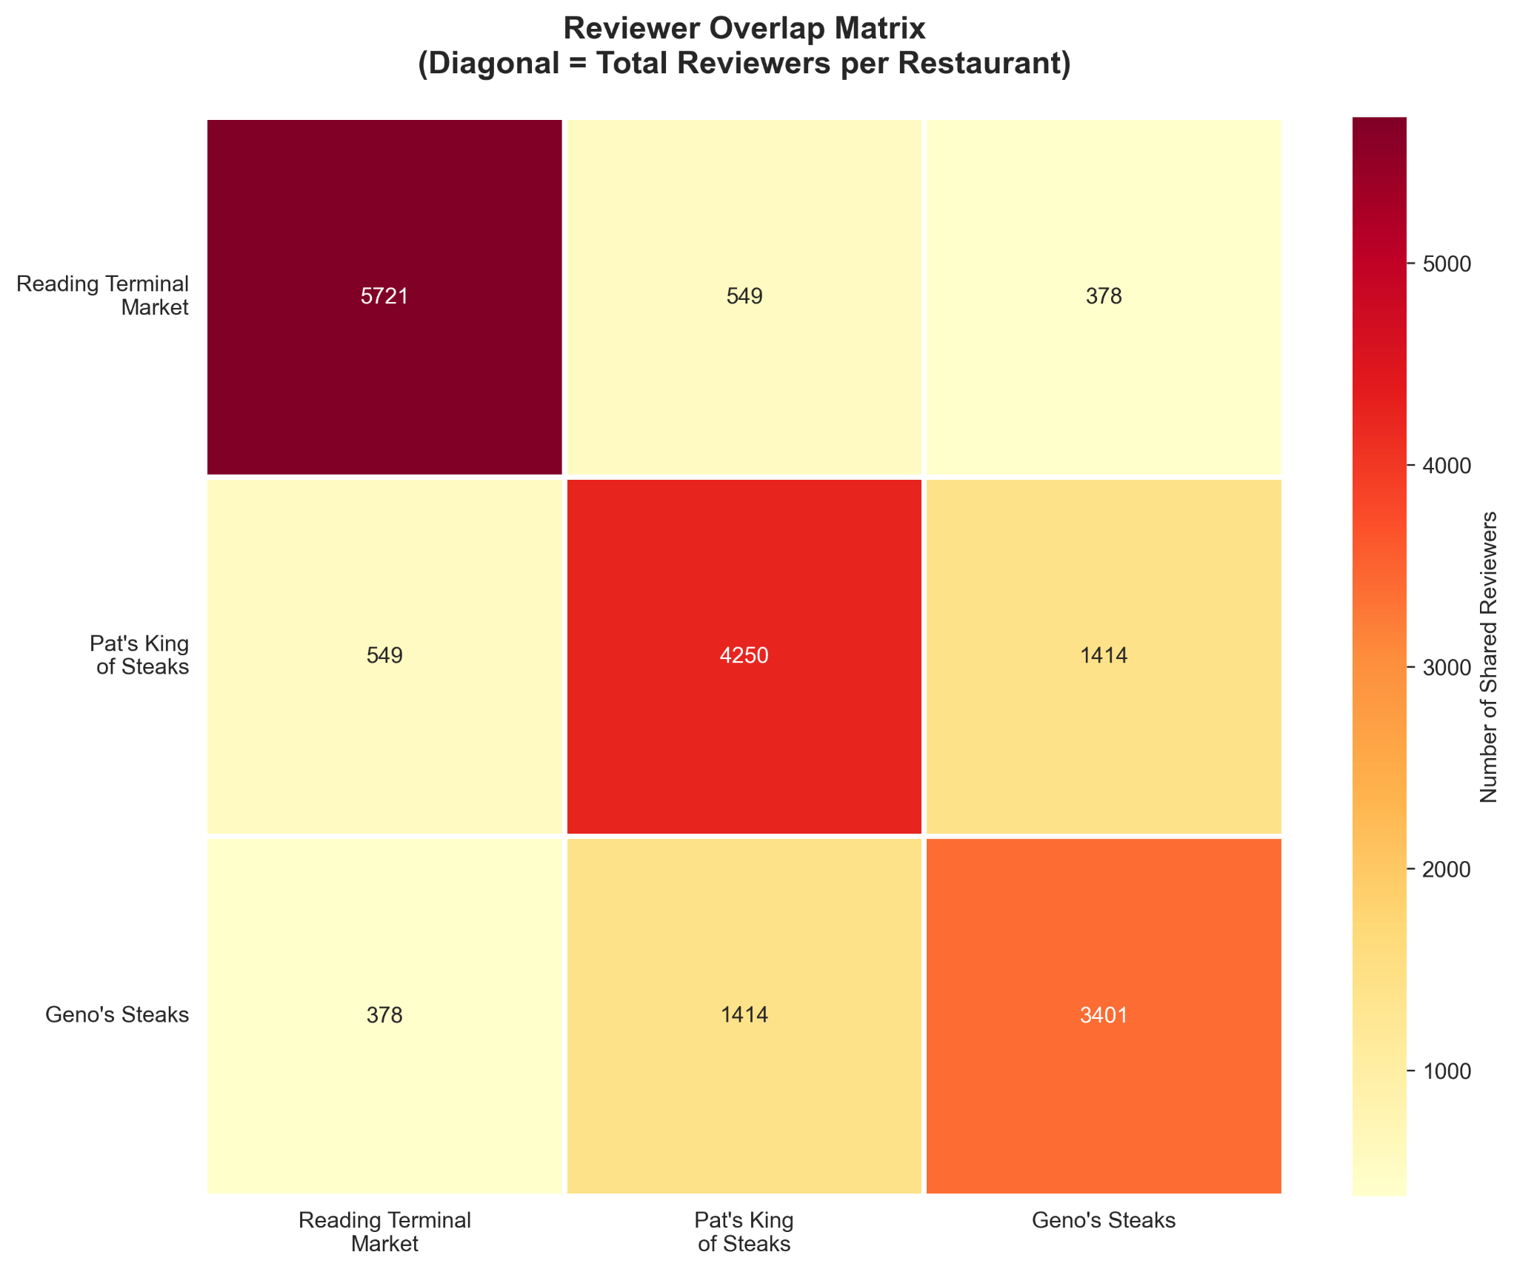
REVIEWER NETWORK STRUCTURE
Total Unique Reviewers: 11,275 across all three restaurants
Single-Restaurant Reviewers (84.6%):
• Reading Terminal Market only: 5,038 users (44.7%)
• Pat's King of Steaks only: 2,531 users (22.5%)
• Geno's Steaks only: 1,853 users (16.4%)
→ Low overlap suggests segmented markets
Cross-Restaurant Reviewers (15.4%):
• Reading Terminal + Pat's: 305 users (2.7%)
• Reading Terminal + Geno's: 134 users (1.2%)
• Pat's + Geno's: 1,170 users (10.4%) ← HIGHEST OVERLAP
• All Three Restaurants: 244 users (2.2%)
→ Direct competitors attract comparative reviewers
Network Preview (from heatmap):
• Reading Terminal ↔ Pat's: 549 shared reviewers
• Reading Terminal ↔ Geno's: 378 shared reviewers
• Pat's ↔ Geno's: 1,414 shared reviewers
→ Strongest network tie: Pat's ↔ Geno's (1,414 total shared users)
Notes:
The Venn diagram reveals limited overall overlap—85% of users review only one restaurant. However, the Pat's-Geno's connection is remarkable: 1,414 users reviewed both, which is 9 times higher than other restaurant pairs. These are customers directly comparing competitors, making them invaluable for understanding competitive dynamics. The heatmap shows connection strength—darker red means more shared reviewers. Notice the strong Pat's-Geno's connection versus the weaker ties to Reading Terminal Market. This pattern will inform our network construction, where shared reviewers become weighted edges connecting restaurant nodes.

Slide 8
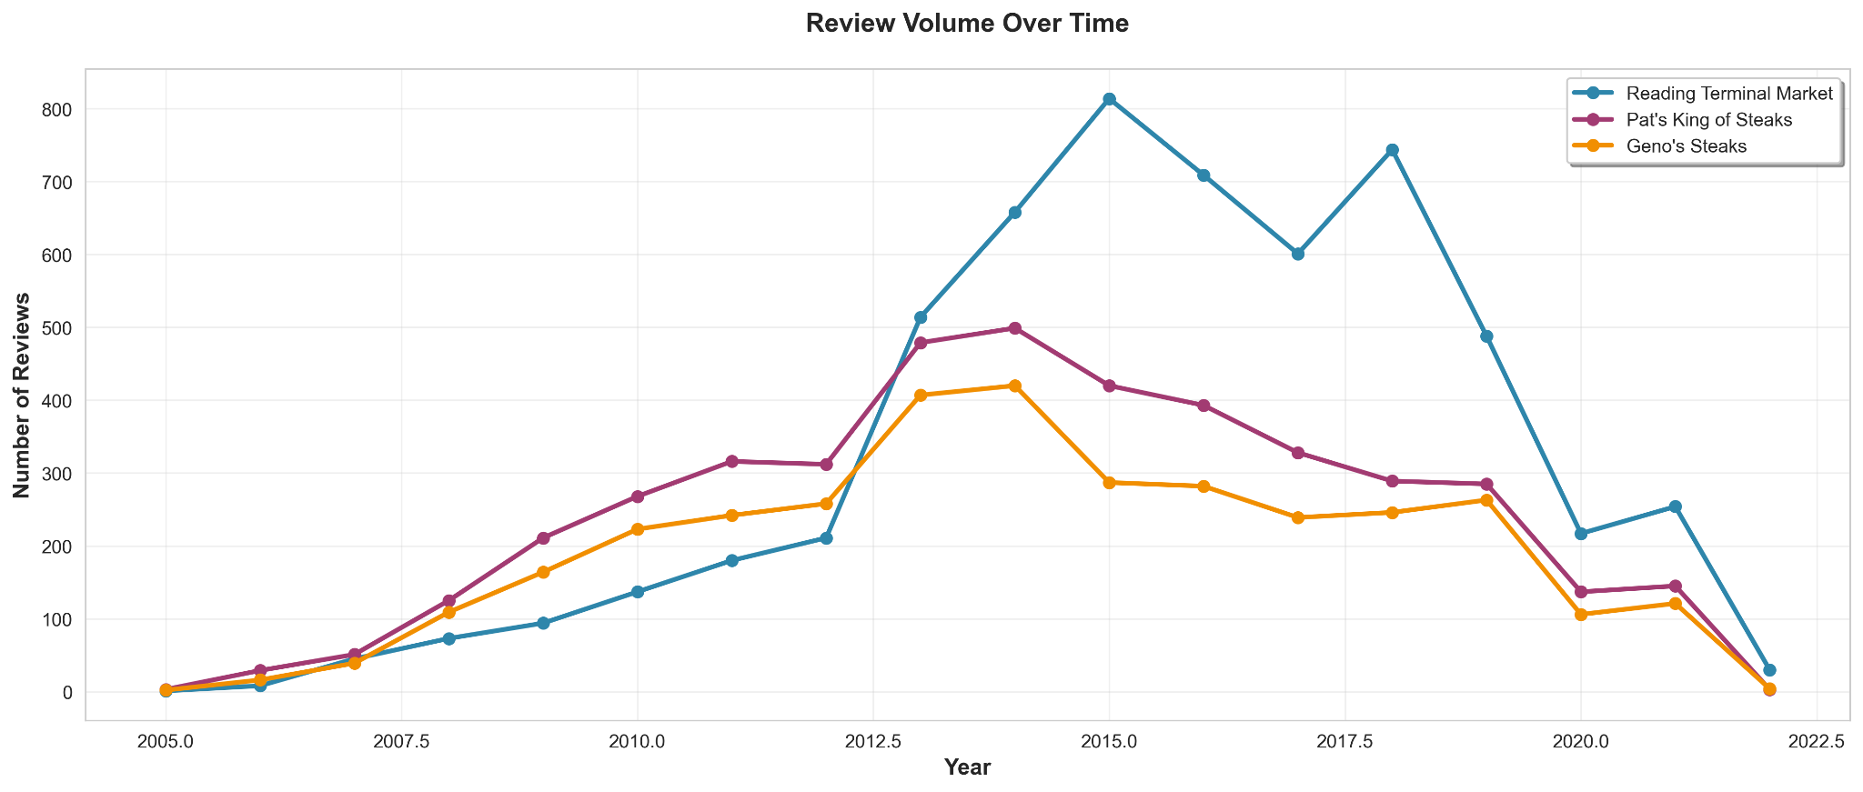
TEMPORAL PATTERNS
Growth Phase (2005-2014):
• All three restaurants show parallel growth
• Reflects Yelp platform expansion
• Philadelphia tourism growth
Peak Period (2014-2018):
• Reading Terminal Market: Peak ~800 reviews/year (2015-2016)
• Pat's King of Steaks: Peak ~500 reviews/year (2014)
• Geno's Steaks: Peak ~425 reviews/year (2014)
Decline Phase (2019-2022):
• Steep decline across all restaurants
• COVID-19 pandemic impact (2020-2022)
• Reduced tourism and dining activity
Notes:
The temporal patterns show fascinating dynamics. All three restaurants experienced parallel growth from 2005 to peak activity around 2014-2016. This reflects both Yelp's platform growth and Philadelphia's increasing popularity as a tourist destination. The recent decline is consistent with COVID-19's impact on restaurant reviewing. For our network analysis, we have robust coverage across multiple years, with the 2014-2018 period offering the densest network data. If we want to examine network evolution, this temporal breadth enables dynamic network analysis.

Slide 9
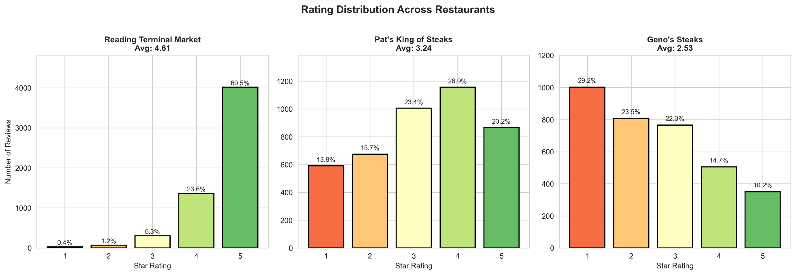
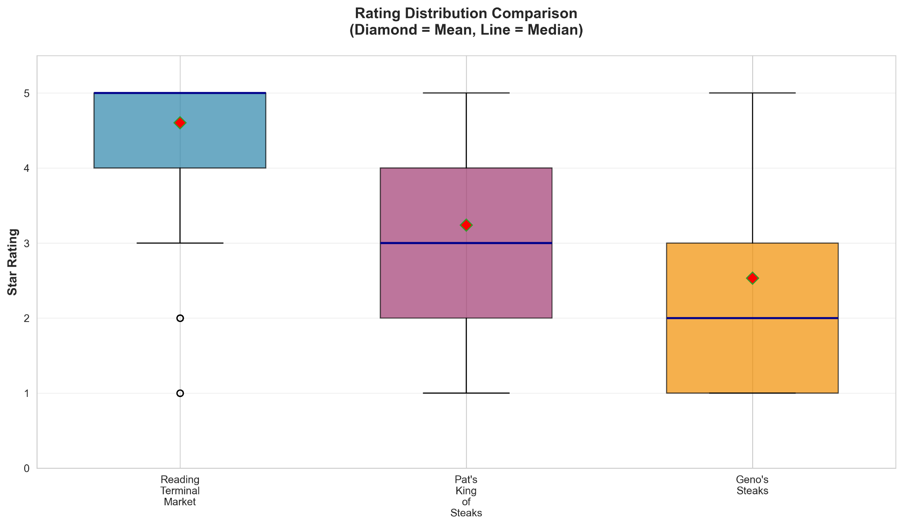
RATING PATTERNS & SATISFACTION ANALYSIS
Reading Terminal Market: 4.61 average (σ = 0.68)
• Distribution: 69.5% five-star, 0.4% one-star
• Median = 5.0, Mode = 5.0
• Right-skewed (high satisfaction)
Pat's King of Steaks: 3.24 average (σ = 1.31)
• Distribution: 20.2% five-star, 13.8% one-star
• Median = 3.0, Bimodal (3★ and 4★)
• Mixed opinions, higher variance
Geno's Steaks: 2.53 average (σ = 1.32)
• Distribution: 10.2% five-star, 29.2% one-star
• Median = 2.0, Mode = 1.0
• Left-skewed (polarized negative)
Notes:
The rating distributions reveal stark performance differences. Reading Terminal shows a classic 'successful venue' pattern—nearly 70% five-star reviews and very low standard deviation, indicating strong consensus. Pat's displays a bimodal distribution with opinions split between satisfied and dissatisfied customers. Geno's shows a troubling pattern with 29% one-star reviews, the worst rating possible.

Slide 10
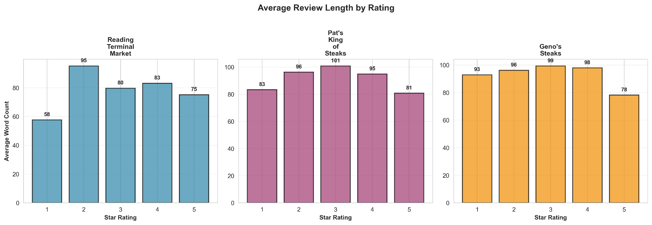
REVIEW CONTENT CHARACTERISTICS
Reading Terminal Market (1-5 stars: 58, 95, 80, 83, 75 words):
• 2-star reviews longest (95 words)
• Disappointed expectations generate detail
Pat's King of Steaks (1-5 stars: 83, 96, 101, 95, 81 words):
• 3-star reviews longest (101 words)
• Mixed feelings require more explanation
Geno's Steaks (1-5 stars: 93, 96, 99, 98, 78 words):
• 1-3 star reviews longer (93-99 words)
• Negative experiences generate detailed critiques
• 5-star reviews shorter (78 words) - fewer very satisfied customers
Average Review Length by Restaurant:
• Reading Terminal Market: 77 words/review
• Pat's King of Steaks: 92 words/review
• Geno's Steaks: 94 words/review
Content Quality:
→ All restaurants: 75-95 word average (substantive reviews)
→ Sufficient detail for sentiment analysis
→ Rich qualitative data for text mining
Notes:
The review length patterns reveal interesting psychological dynamics. Reading Terminal shows a classic pattern where extreme opinions generate longer reviews. But Pat's is fascinating—3-star reviews are the LONGEST at 101 words because customers take time to explain both what they liked and didn't like. 'The cheesesteak was good BUT the service was slow' requires more words than 'Amazing!' or 'Terrible!' Geno's shows consistently long reviews across low ratings, suggesting customers feel compelled to justify negative experiences. These patterns suggest review length reflects not just engagement intensity, but also the complexity of the experience. For network analysis, review length could serve as a measure of reviewer engagement and decision difficulty.

Slide 11
Baseline Logistic Regression Model

Slide 12
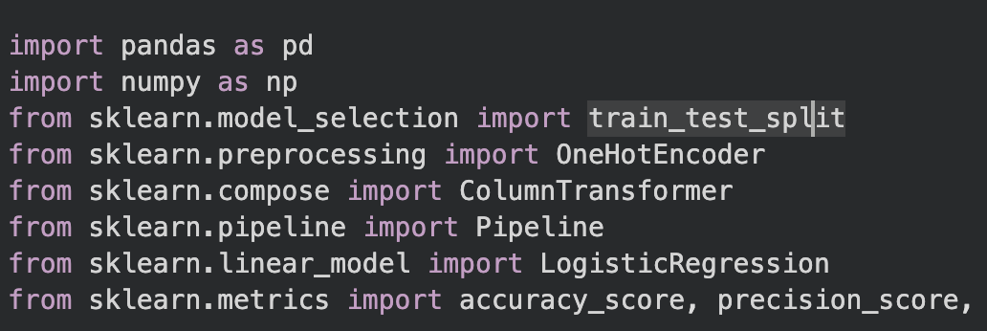
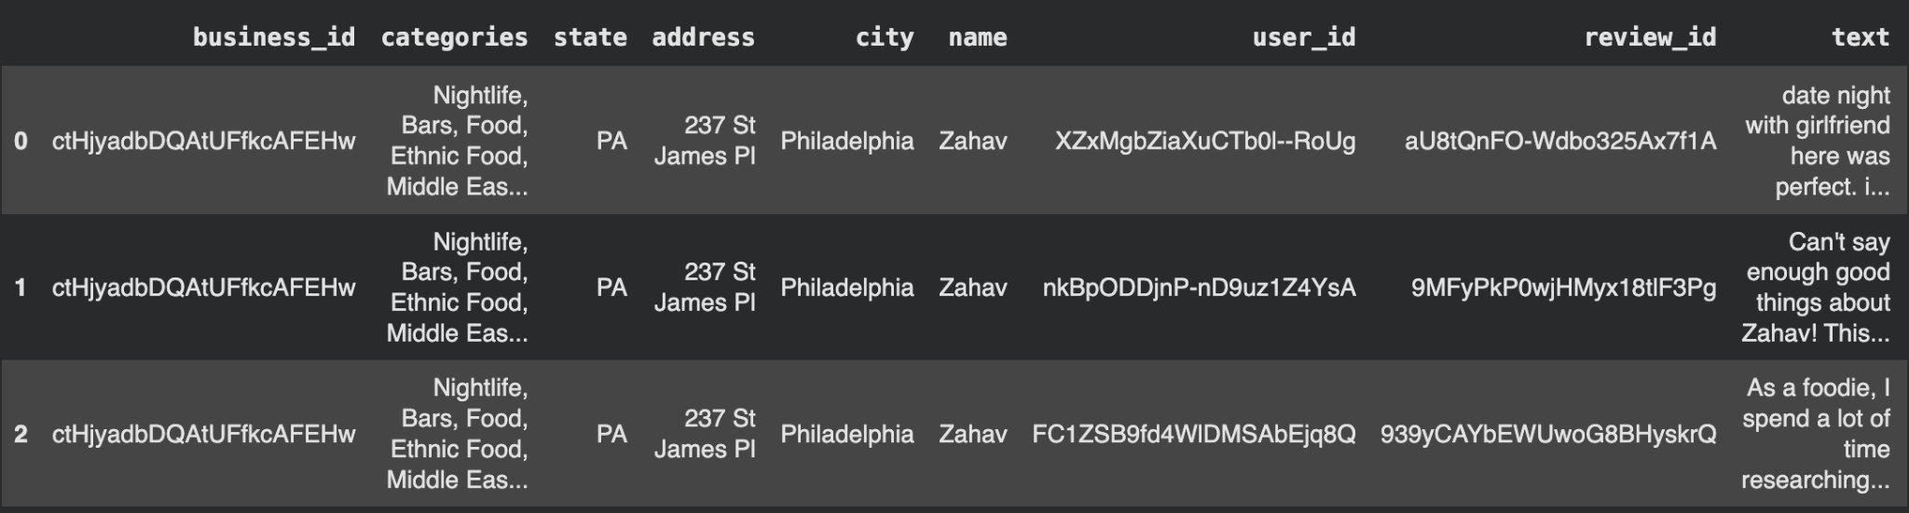
Goal: Build a simple classification model to predict High (≥4 stars) vs Low (<4 stars) restaurant ratings.
Features Used (Structured Only):
Categorical: categories, state, city, name
Encoded using One-Hot Encoding
Method:
Logistic Regression (baseline)
70/30 split, stratified by label
Pipeline: preprocessing + model training

Slide 13
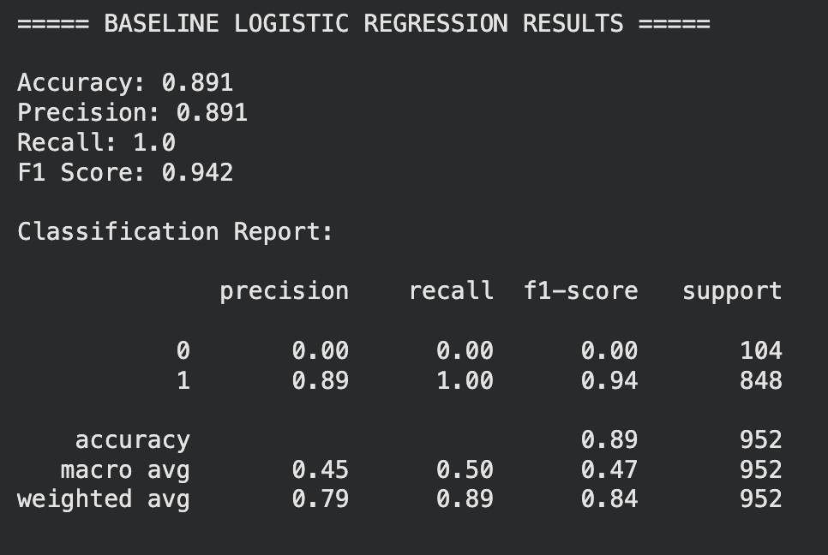
Severe class imbalance (848 high vs 104 low)
Categorical features (categories, city, name) do not carry enough signal to separate good vs bad restaurants.
No information about review text, sentiment, or customer experience is included.
Notes:
The upcoming NLP model will add:
TF-IDF review vectors
Keyword and sentiment patterns
More expressive features capturing quality, service, taste, cleanliness, etc.
→ Expect major improvements in class-0 detection and overall balance.

Slide 14
NLP Based Model
Why NLP?
Customer sentiment is expressed through words, not categories.
The NLP model extracts meaning directly from review text.

Slide 15
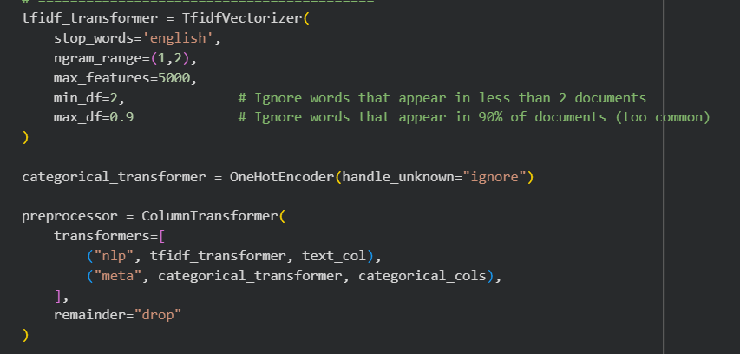
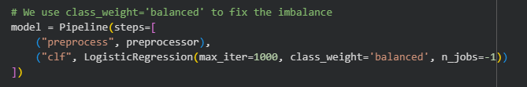
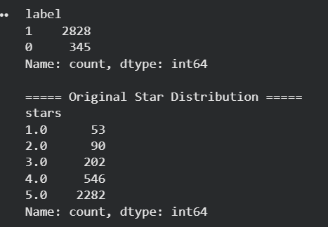
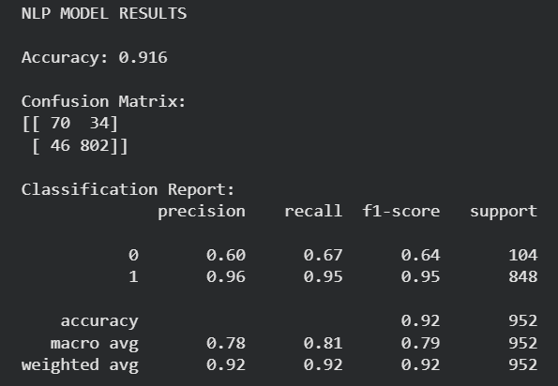
TF-IDF + Metadata + Logistic Regression
1.Text Processing (TF-IDF Vectorizer)
Converts review text into numerical features
Removes stopwords
Uses bigrams to capture short phrases (‘decent’ & ‘pretty decent’)
Filters rare and overly common words
Produces a 5000-dim vocabulary representing key sentiment expressions
2. Metadata Encoding
OneHotEncoder for state and city
Helps capture regional sentiment variations
3. Classification Layer
Logistic Regression with class_weight='balanced'
Handles class imbalance directly
Fully optimized with GridSearchCV (F1-macro scoring)
Notes:
In order to address the class imbalance and a better model - NLP-based binary classification model to analyze text data and identify whether each entry belongs to Class 0 or Class 1.
We used TF-IDF vectorization which helped us achieve an overall accuracy of 91.6%, which is strong, but accuracy alone does not reveal full model performance—especially because the dataset is highly imbalanced, with Class 1 dominating.
When we look deeper at the baseline confusion matrix, we see that while the model performs extremely well on Class 1, with a precision and recall both near 0.95 , its performance on Class 0 is significantly weaker. Class 0 achieved only 0.60 precision and 0.67 recall.
This imbalance means the model tends to misclassify minority-class examples. So, the goal was not just to increase accuracy, but to improve class-level balance, reduce misclassifications, and build a more generalizable model so we move on to the next stage which is hyper parameter tuning.

Slide 16
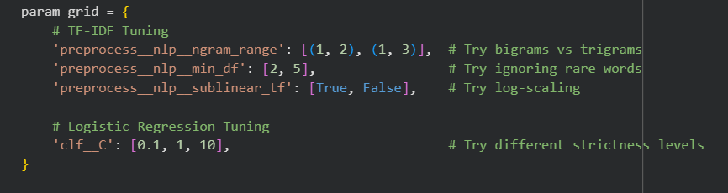
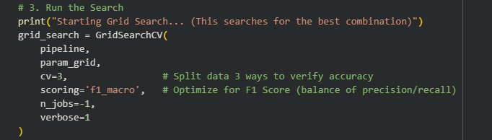
Improving the NLP Model with Hyperparameter Tuning (GridSearchCV)
What We Tuned
1. TF-IDF (Text Vectorization) Parameters
n-gram range → capture more context
(1, 2) = unigrams + bigrams
(1, 3) = unigrams + bigrams + trigrams
min_df → remove noisy rare words
2 vs 5 minimum document frequency
sublinear_tf → log-scale term frequencies
Helps reduce bias from very frequent words
GridSearchCV will try every possible combination of this list to find the best hyperparemeter
2. Logistic Regression Parameters
C (inverse regularization strength)
Controls model flexibility
Values examined: 0.1, 1, 10
GridSearch tested every combination across 3-fold cross-validation, optimizing F1-macro for balanced performance across classes.
GridSearch trains 24 × 3 = 72 models under the hood.
Notes:
In the next step of the project, I improved the NLP model using GridSearchCV for hyperparameter tuning.
It uses GridSearchCV, which brute-forces through all possible combinations of hyperparameters you specify in param_grid and finds the combination that gives the best F1 score.
GridSearchCV essentially acts as an automated system that tests different combinations of model settings to find the best-performing version of the pipeline.
ngram_range will search through every possible combination of (uni & bigrams) and (uni, bi, trigrams), min_df will ignore words that appear in fewer than 2 or 5 documents and sublinear_tf will decide whether to log-scale term frequencies.
So GridSearch trains 24 × 3 = 72 models under the hood.
And for logistic regression, I specify different values for the regularization strength, C. The Inverse regularization strength implies that the higher it is = more flexible model)
Once this search space is defined, GridSearchCV tries every possible combination of these hyperparameters. And instead of testing them on just one train-test split, it uses cross-validation, which means the data is split into multiple folds. Each combination is trained and evaluated several times on different portions of the data.
After scoring each combination—using F1-macro in my case—GridSearchCV identifies which hyperparameters consistently performed the best across all folds.
The key advantage here is that the final model isn’t tuned to just one split of the data. Instead, it is chosen based on repeated, systematic evaluation, making it more reliable, more robust, and less prone to overfitting.
So, GridSearchCV ensures that the version of the NLP model I deploy is the strongest and most generalizable configuration of the pipeline

Slide 17
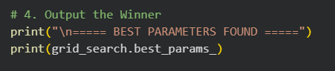
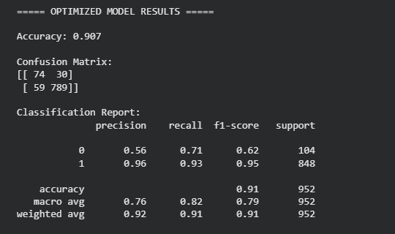
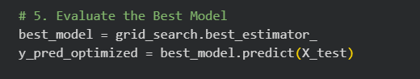
Notes:
Although the overall accuracy remained nearly the same after tuning, the optimized model became significantly more balanced and reliable. The reduction in false negatives for Class 0 from 34 to 30 + an increase in recall, shows that the tuned model is now better at correctly identifying minority-class instances that the NLP model missed.
This improvement is especially important in scenarios where overlooking a minority-class case can have meaningful consequences. If Class 0 corresponds to a rare but critical event—such as a high-risk customer profile, a potential fraud signal, or a crucial support requestidentifying more of these cases directly increases the real-world usefulness of the model.
In summary, hyperparameter tuning resulted in a model that is more stable, fair, and trustworthy, with improved performance across both majority and minority classes. The final model achieves a stronger balance between precision, recall, and generalization making it far more suitable for deployment and real-world decision-making.

Slide 18
Hybrid Model (Numeric + Text)

Slide 19
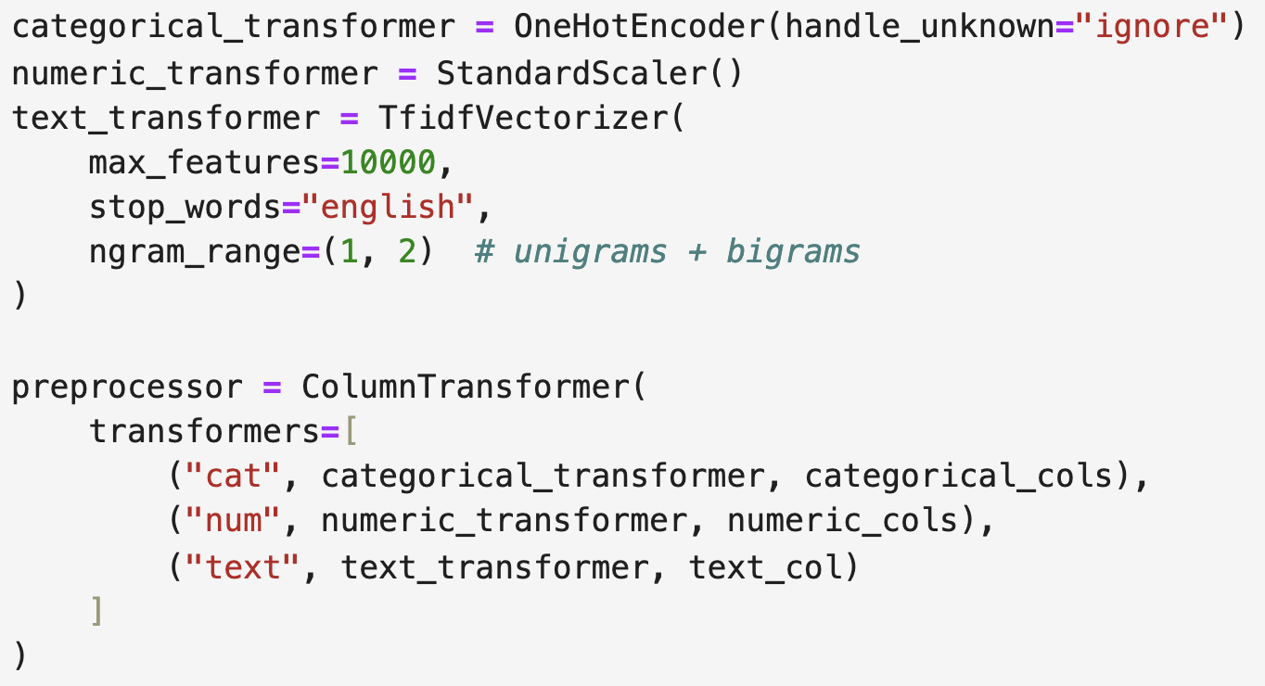
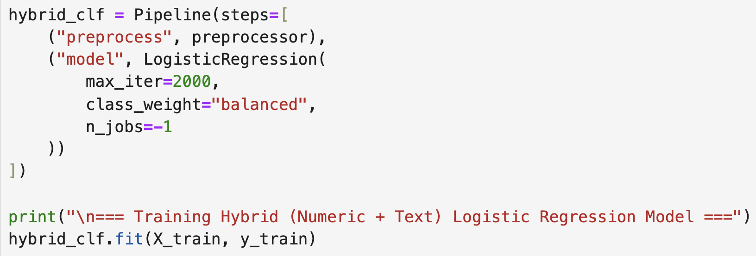
Hybrid model
Combines structured features (categories, city, name) with unstructured review text.
Added simple numeric features such as review length (chars & words).
Text transformed using TF-IDF to capture sentiment and key phrases.
Preprocessing done with ColumnTransformer (OneHot + Scaling + TF-IDF).
Logistic Regression used to handle class imbalance and mixed feature types.
Notes:
These three restaurants represent distinct market positions. Reading Terminal is a beloved food hall with consistently high ratings. Pat's and Geno's are direct competitors—literally across the street—yet show dramatically different customer satisfaction. This variation is methodologically valuable for testing how performance affects network structure. The mix of a food hall versus direct competitors also allows us to examine complementary versus competitive network patterns.

Slide 20
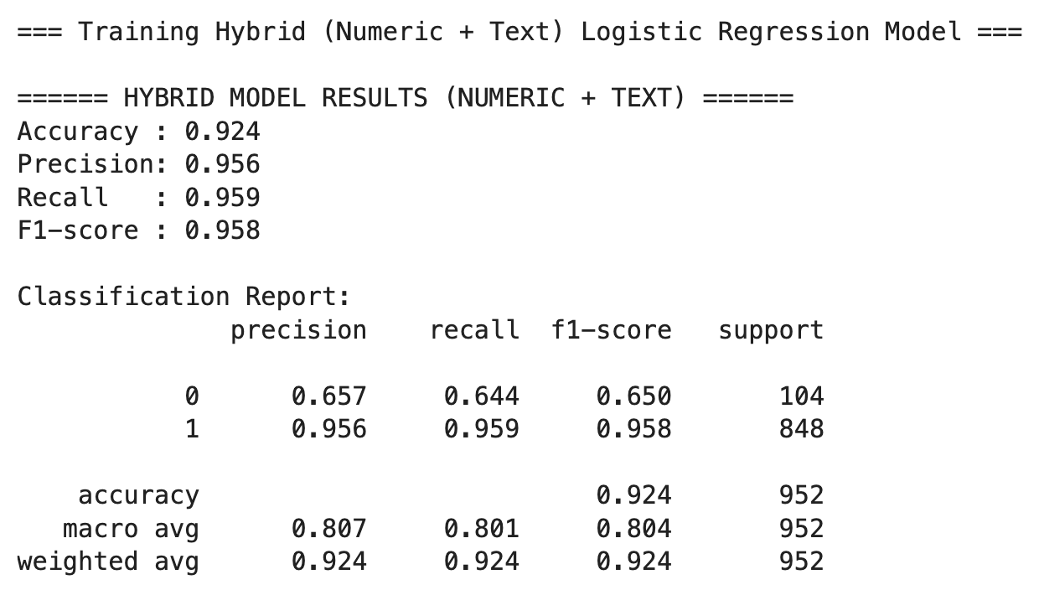
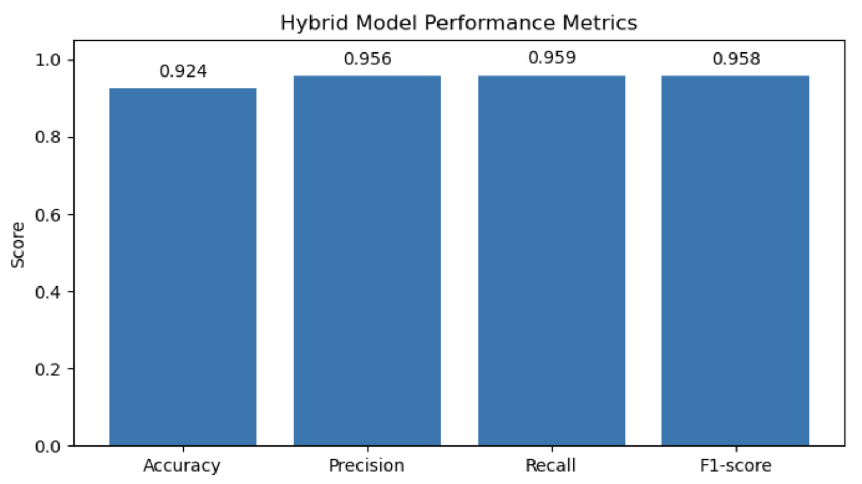
Model Performance
Accuracy: 92.4%
Precision: 95.6%
Recall: 95.9%
F1 Score: 95.8%
Hybrid model improves prediction by using both numeric and text features.
Strong overall performance with 92–96% across all metrics.
Shows the hybrid model is accurate, consistent, and balanced on the dataset.
Notes:
The rating distributions reveal stark performance differences. Reading Terminal shows a classic 'successful venue' pattern—nearly 70% five-star reviews and very low standard deviation, indicating strong consensus. Pat's displays a bimodal distribution with opinions split between satisfied and dissatisfied customers. Geno's shows a troubling pattern with 29% one-star reviews, the worst rating possible.

Slide 21
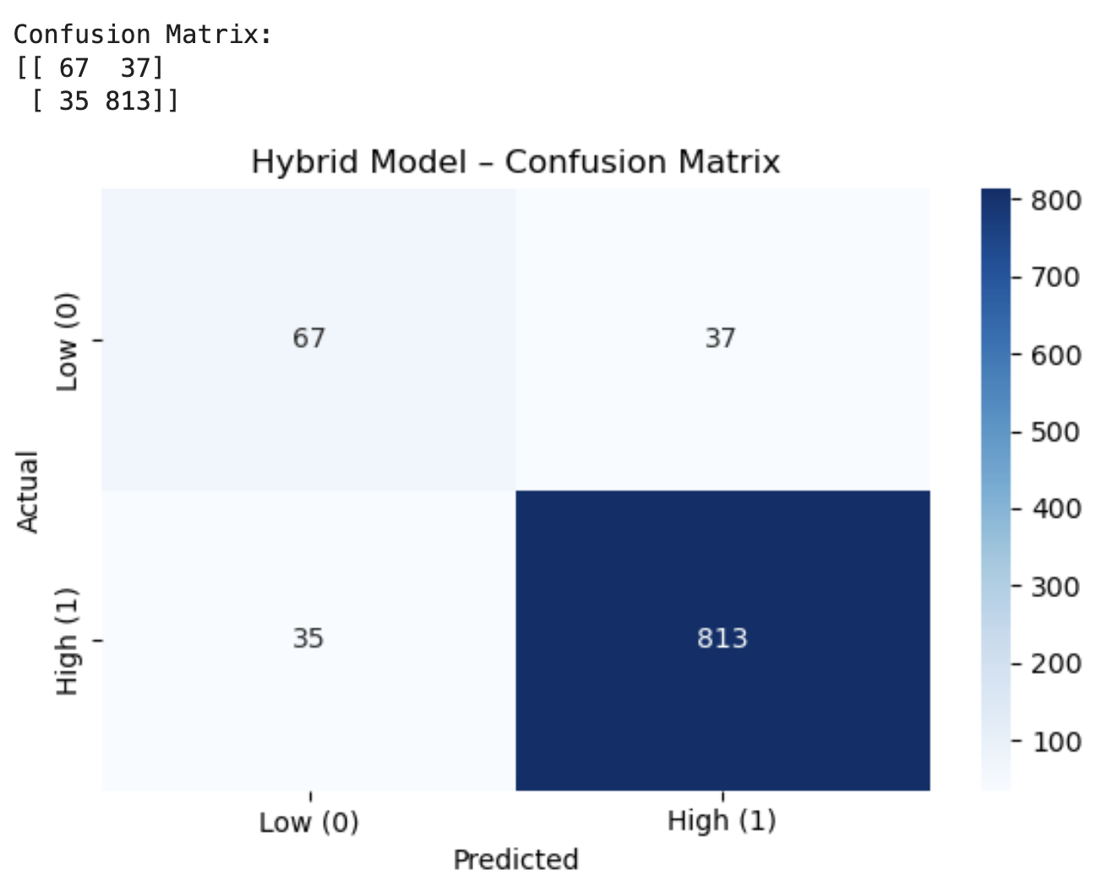
Model Performance
The model correctly predicts most high (813) and several low (67) reviews.
Mistakes occur mainly on neutral reviews like “ok” or “average.”
Accuracy: 92.4%
Precision: 95.6%
Recall: 95.9%
F1 Score: 95.8%
Hybrid model improves prediction by using both numeric and text features.
Strong overall performance with 92–96% across all metrics.
Shows the hybrid model is accurate, consistent, and balanced on the dataset.
Notes:
The rating distributions reveal stark performance differences. Reading Terminal shows a classic 'successful venue' pattern—nearly 70% five-star reviews and very low standard deviation, indicating strong consensus. Pat's displays a bimodal distribution with opinions split between satisfied and dissatisfied customers. Geno's shows a troubling pattern with 29% one-star reviews, the worst rating possible.

Slide 22
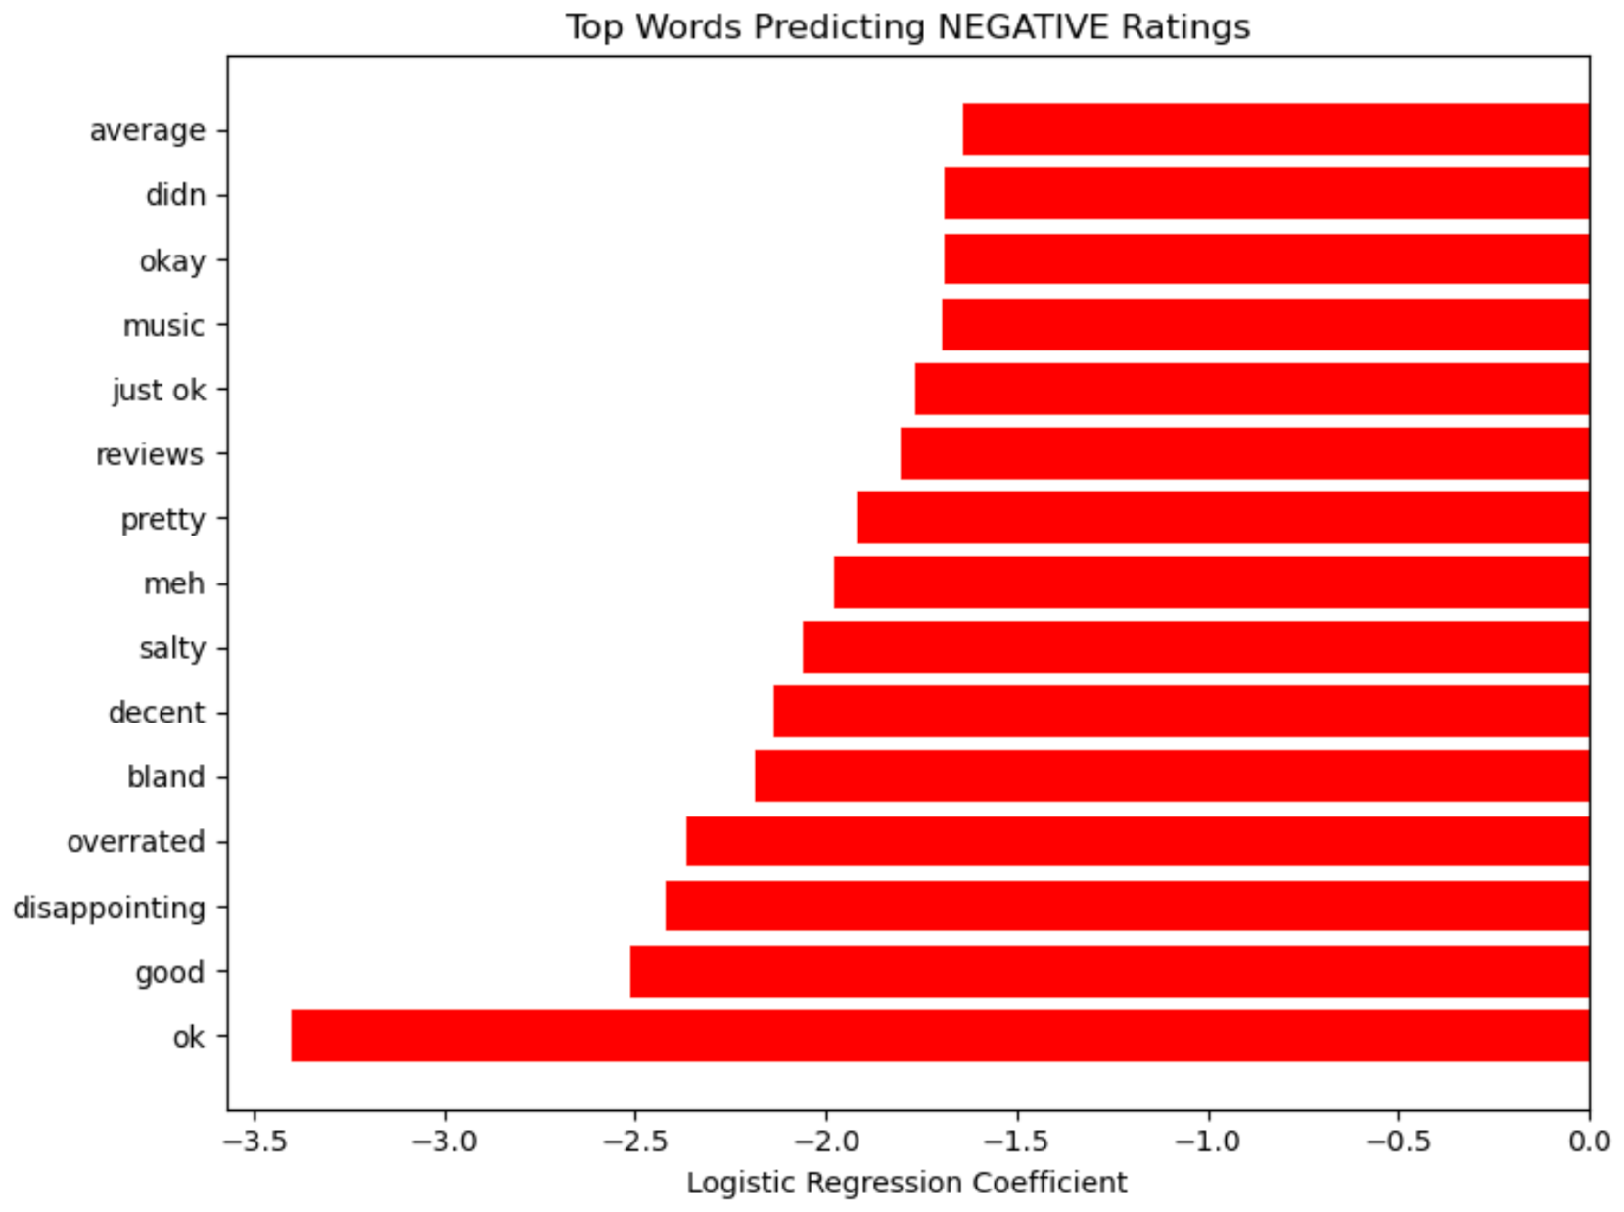
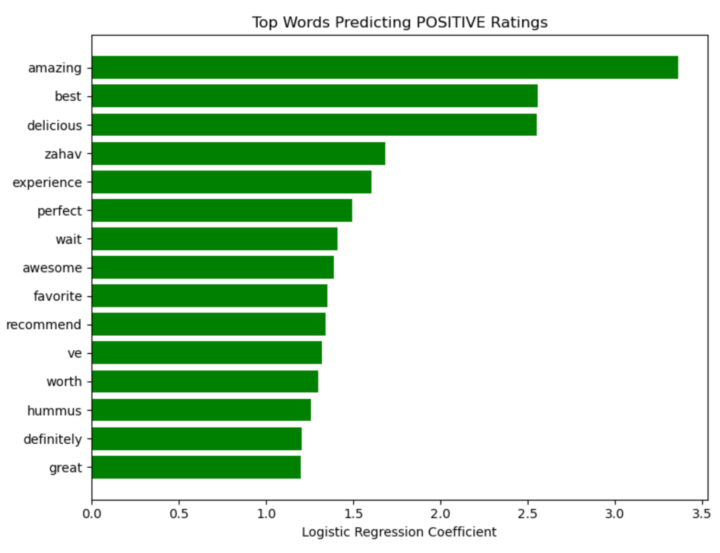
What Causes Negative Reviews
Negative reviews commonly use soft negative language such as “ok,” “average,” “bland,” “overrated,” and “disappointing.”
These words indicate mild dissatisfaction or unmet expectations rather than extreme criticism.
Positive reviews use strong sentiment words like “amazing,” “delicious,” “perfect,” “worth,” and “great.”
These words reflect high satisfaction and strong recommendations.
Comparing both charts:
Negative words = Not satisfied experiences
Positive words = Enthusiastic, emotionally strong reviews
This demonstrates that the hybrid model effectively identifies language differences that separate low vs. high ratings.
Notes:
These three restaurants represent distinct market positions. Reading Terminal is a beloved food hall with consistently high ratings. Pat's and Geno's are direct competitors—literally across the street—yet show dramatically different customer satisfaction. This variation is methodologically valuable for testing how performance affects network structure. The mix of a food hall versus direct competitors also allows us to examine complementary versus competitive network patterns.

Slide 23
Take Away

Slide 24

Thank You!
GO GREEN

